Slide 1

innovative Energy Storage TEchnologies TOwards increased Renewables integration and Efficient Operation

Slide 2

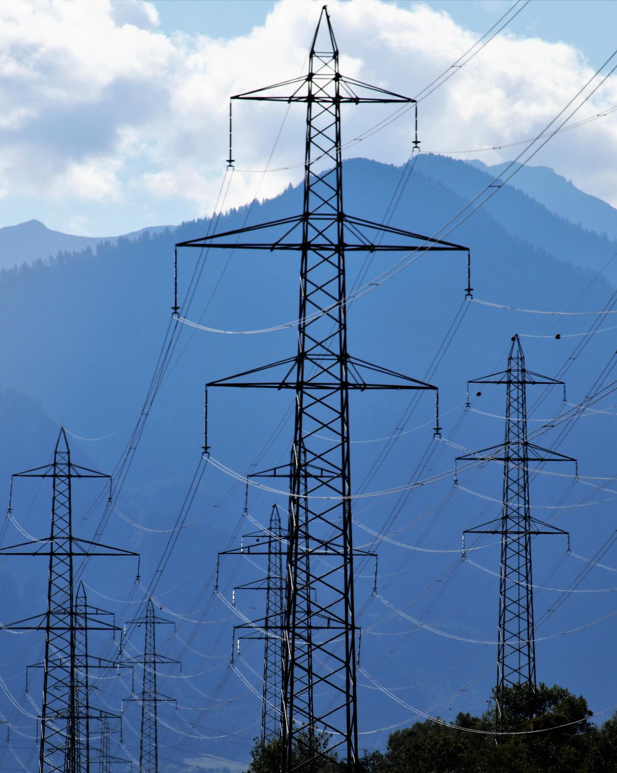
EMPOWERING GREEN ENERGY WITH INNOVATIVE STORAGE SYSTEMS
The Horizon Europe Energy Project, i-STENTORE – innovative Energy Storage TEchnologies TOwards increased Renewables integration and Efficient Operation, will examine the integration of diverse storage solutions and their combinations in various applications covering mobility, agricultural, industry, household, heating and other sectors.

Slide 3
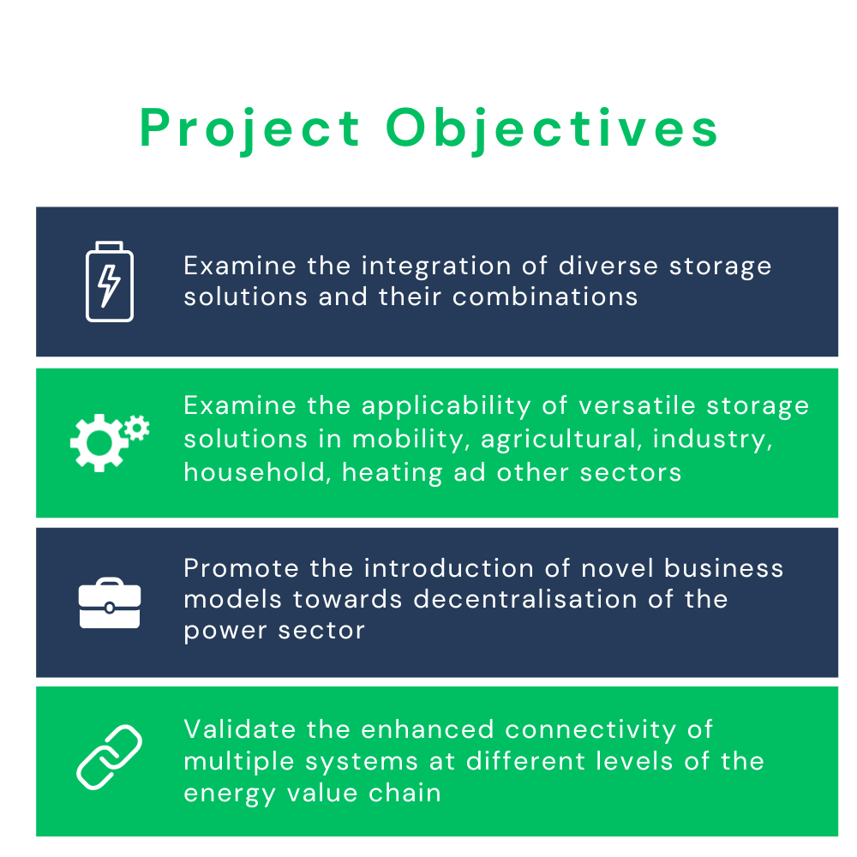
PROJECT
OBJECTIVES

Slide 4

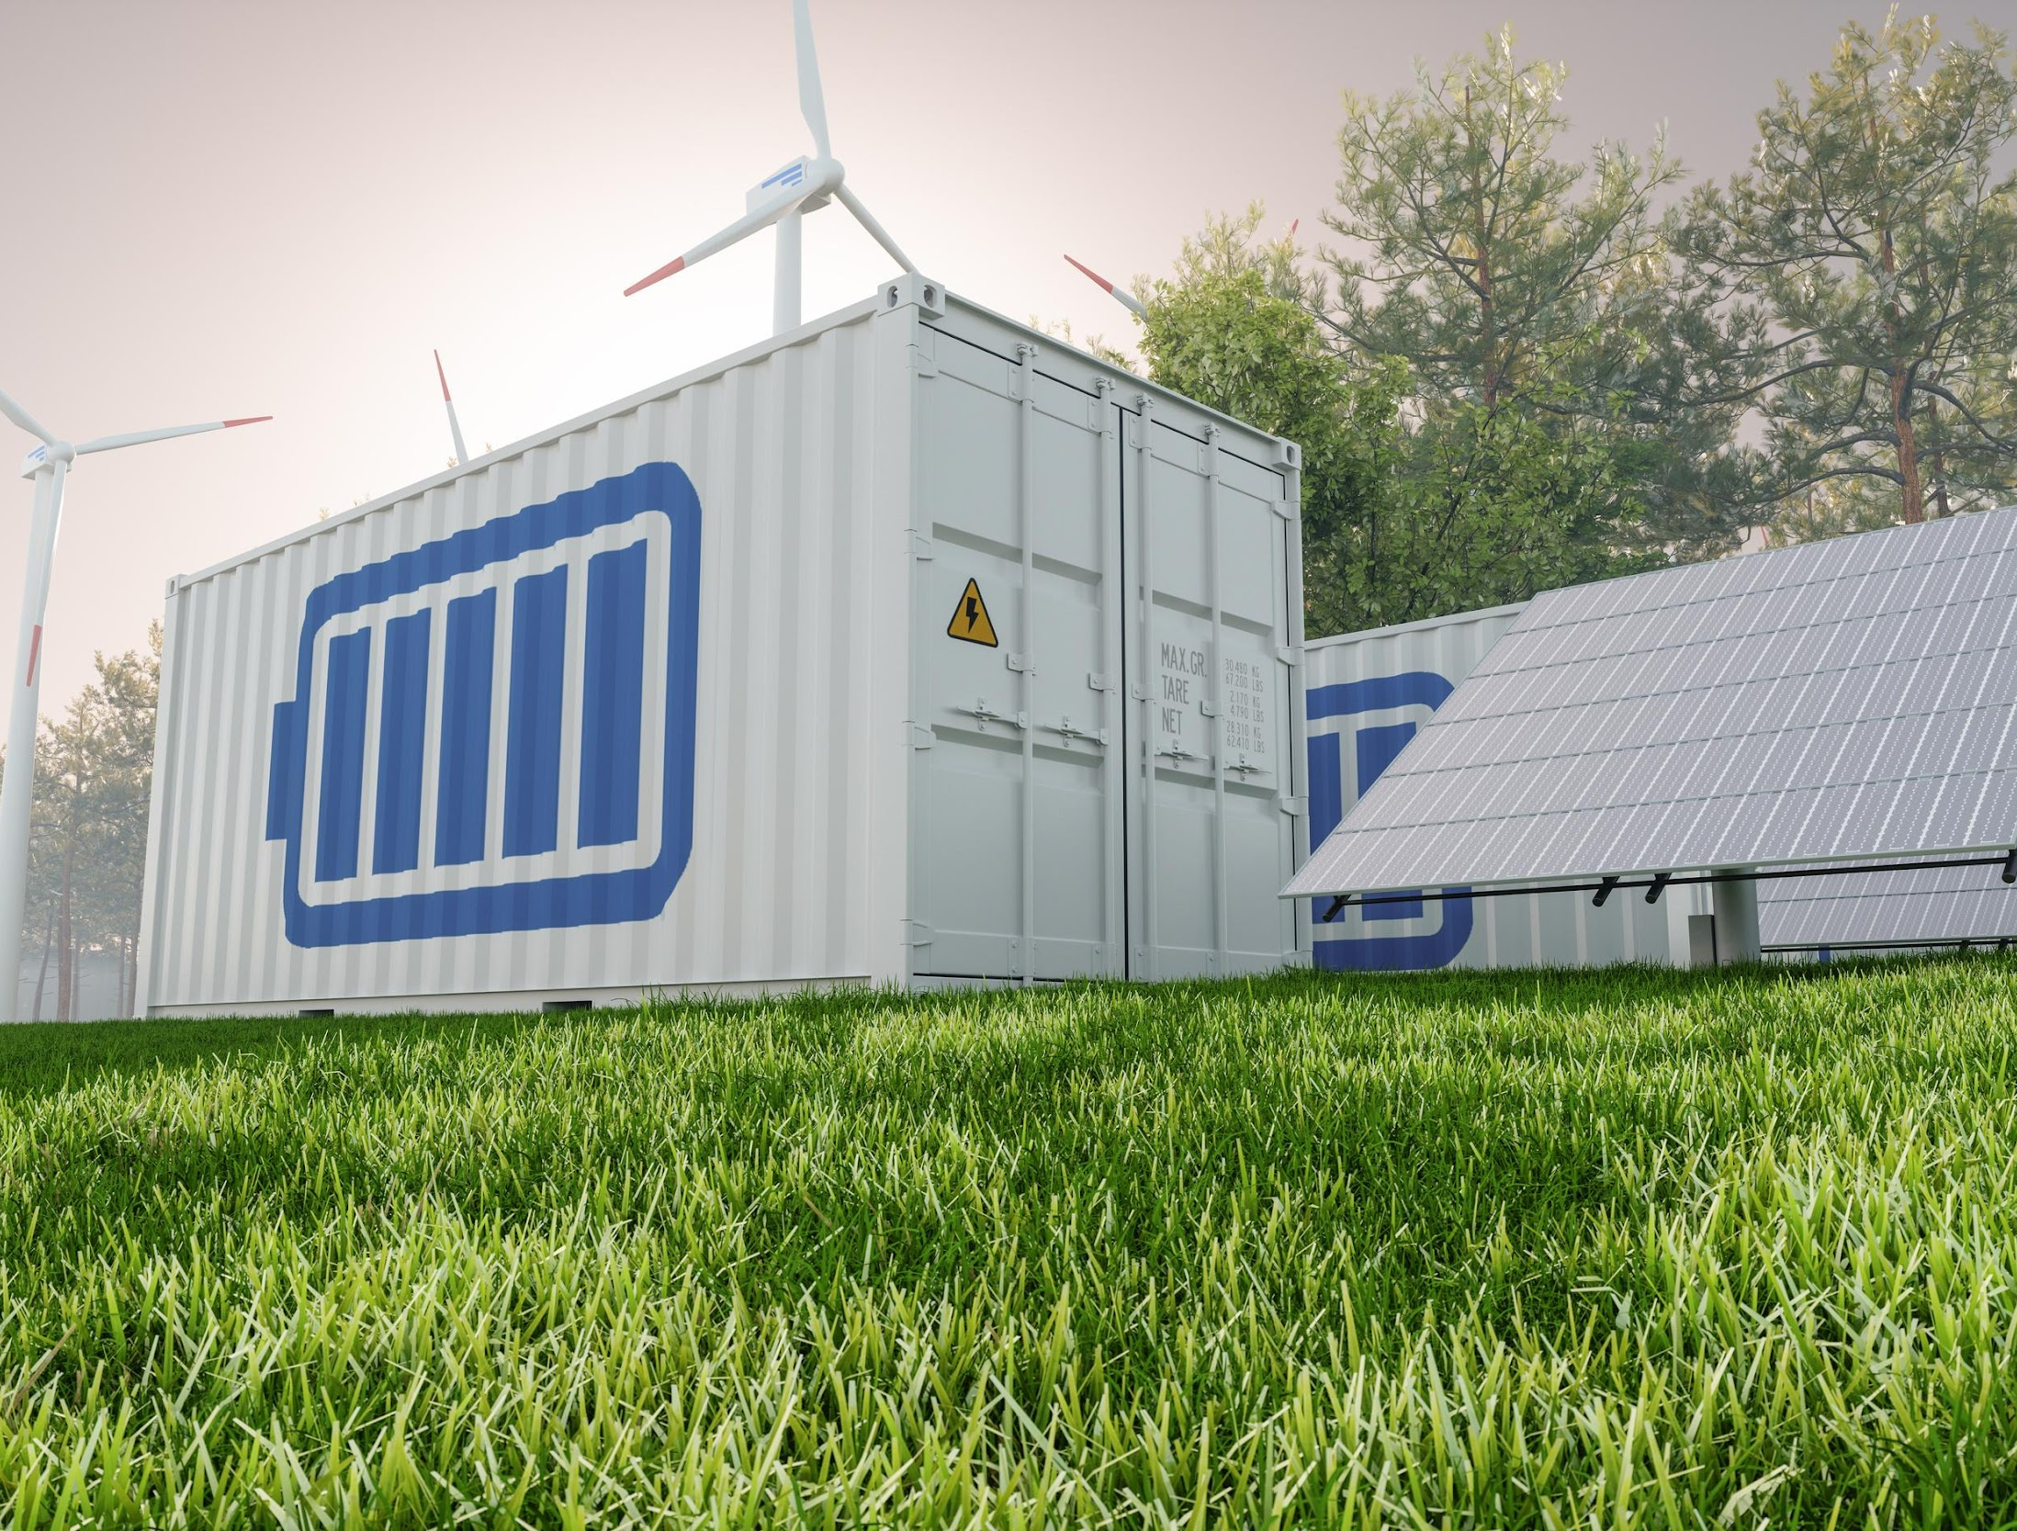

i-STENTORE
DEMONSTRATORS
i-STENTORE Demonstration and Validation (Demos)

Slide 5
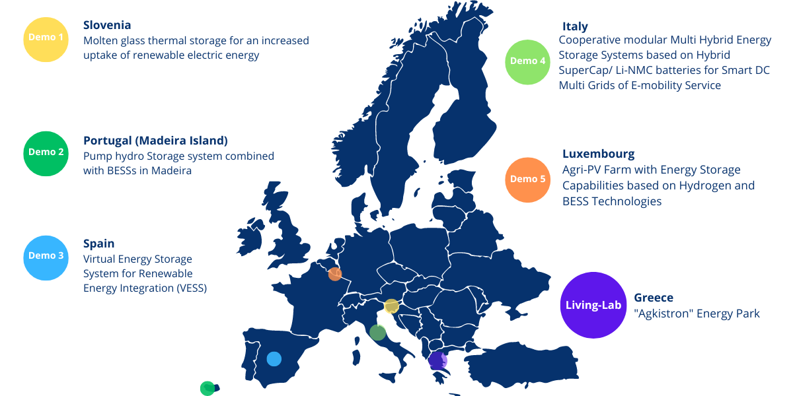
The overall i-STENTORE framework will be applied, implemented, and validated in 5 real-life demos, and 1 Living Lab, across 6 countries.

Slide 6
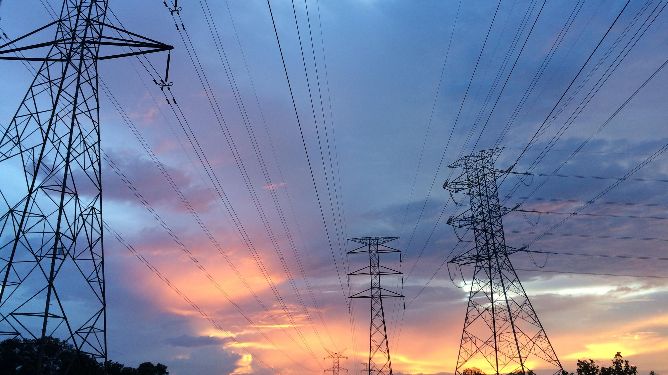
These scenarios will be monitored and evaluated to assess the potential to scale and replicate the results achieved in the demo, as well as through the use of a methodological framework for assessment of i-STENTORE from a technological, economic, societal, environmental, regulatory perspective.

Slide 7

We will cover to the largest possible extent a versatile mix of energy storage technologies, covering energy intensive applications in different sectors including industry, agriculture, commercial applications, and mobility.
The activities will focus on illustrating specific functions and serving real needs and existing challenges, engaging different actors of the energy storage value chain with different characteristics, such as storage and micro-grid operators and DSOs showcasing new business concepts, highlighting the multi-purpose potential of storage and examining different timeframes for service-provisioning.

Slide 8

This holistic approach will enable to test the non-exhaustive set of i-STENTORE technological solutions and services which could be expanded by third parties in the future.

Slide 9
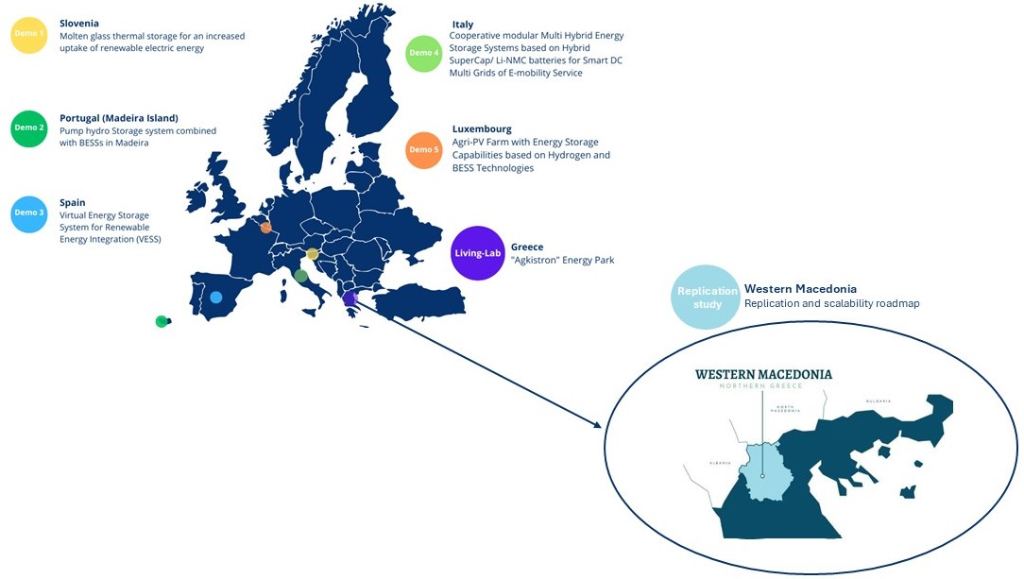
Two-way replication process for solutions and lessons learned
Conduct a multiplier study targeting applications in the Western Macedonia region
Develop a roadmap for scalability and replicability at EU level
Evaluate potential outcomes and impacts of scaling up and replicating

Slide 10
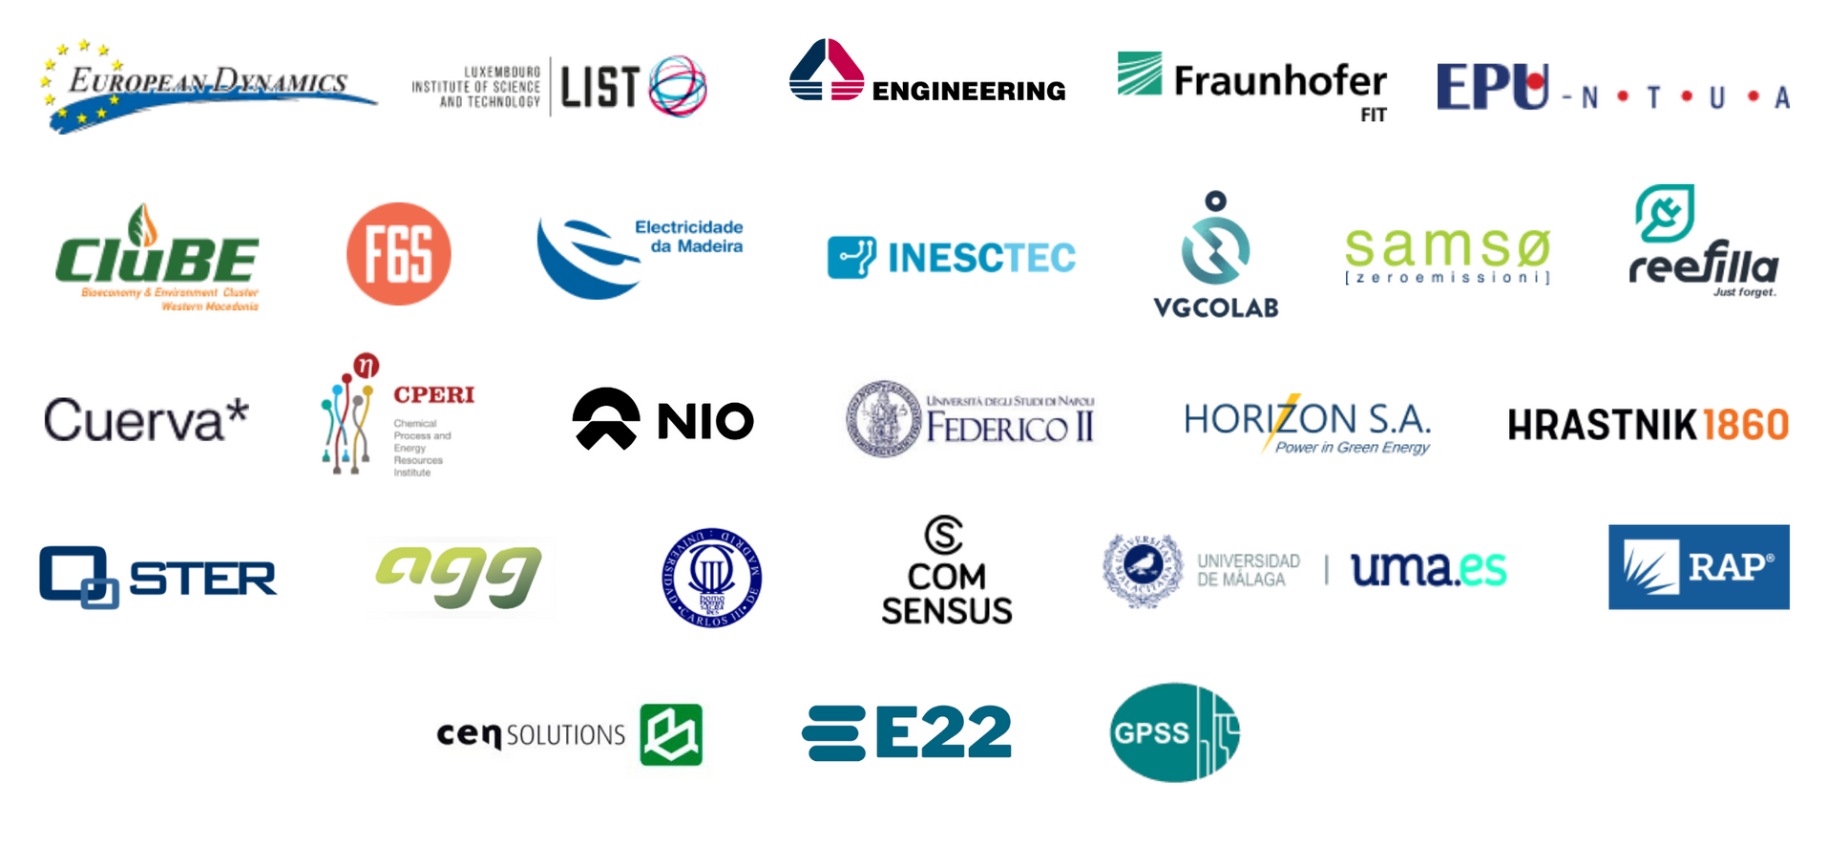

POWERED BY

Slide 11


www.istentore.eu
iSTENTORE
@iSTENTORE_EU
info@istentore.eu
FOLLOW US

